Slide 1
Social Media Sentiment Analysis

Slide 2
Description:
This project aims to understand sentiment changes from 2010 to 2023 on popular social media platforms based on certain attributes and how they impact each other.
This project explores the standard procedure of data analysis, including data preprocessing, feature engineering, EDA and supervised machine learning.
This project introduces the standard procedure of natural language processing(text clearning, word embedding, etc.), and used multiclass classification models for sentiment analysis.
This proect optimizes text classification using pre-trained LLM model BERT, and preprocess datasets from dataframe to datasets in tensors using pytorch.
This project leverages some popular data-analyic tools, including pandas, matplotlib, seaborn, sckiitlearn and a decent usage of natural language processing tool-nltk.

Slide 3
Dataset:
This dataset is a Kaggle Dataset named 'Social Media Sentiments Analysis Dataset’.
It captures a vibrant tapestry of emotions, trends, and interactions across various social media platforms.
This dataset provides a snapshot of user-generated content, encompassing text, timestamps, hashtags, countries, likes, and retweets. Each entry unveils unique stories—moments of surprise, excitement, admiration, thrill, contentment, and more—shared by individuals worldwide.

Slide 4
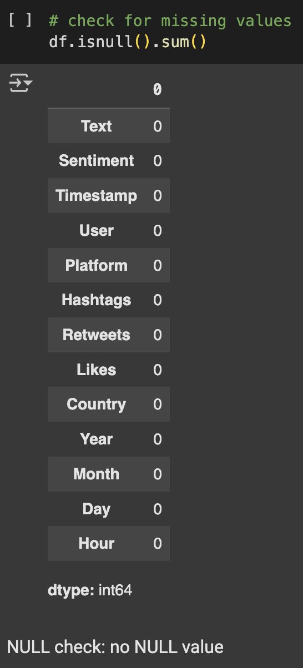
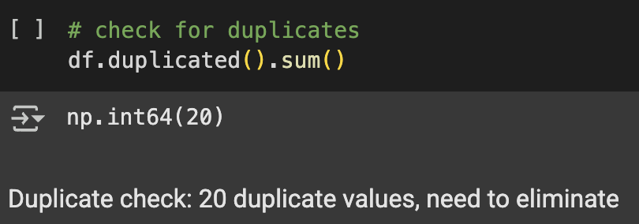
About dataset:
The dataset has no nulls. It has 20 duplicates.

Slide 5
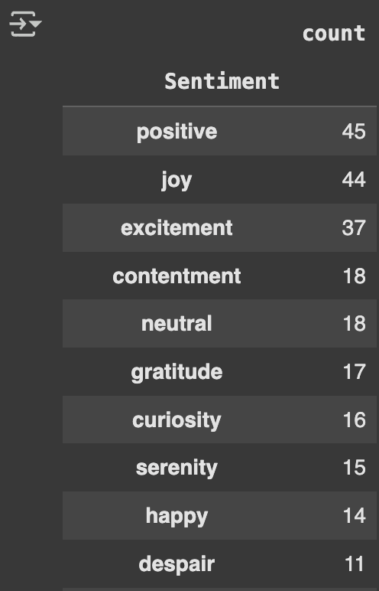
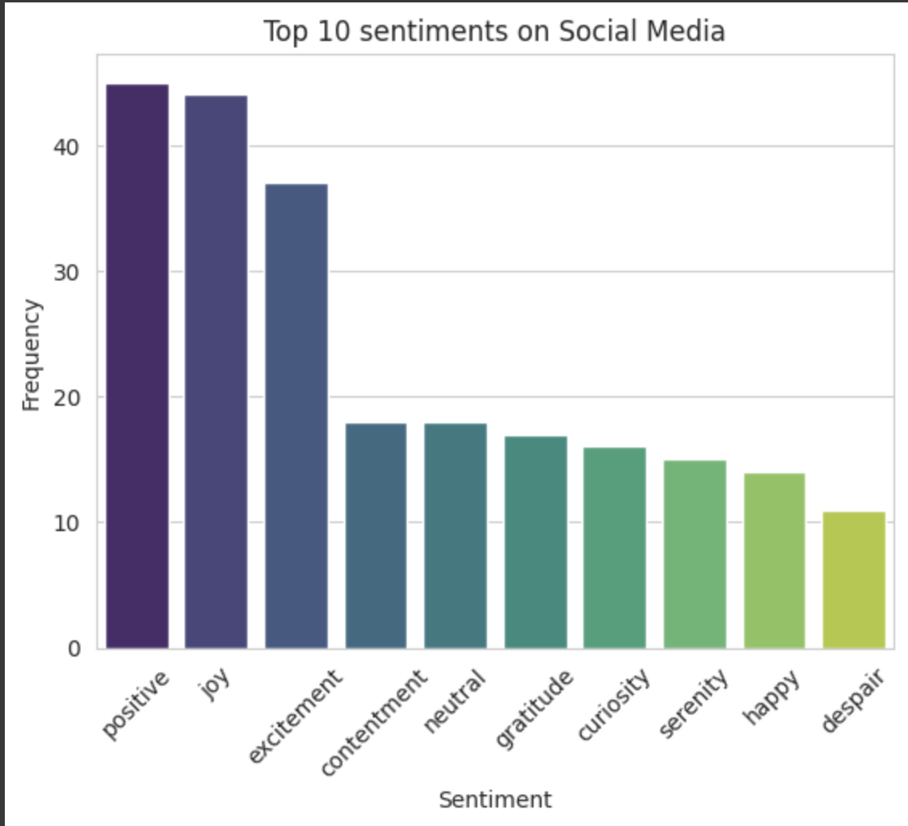
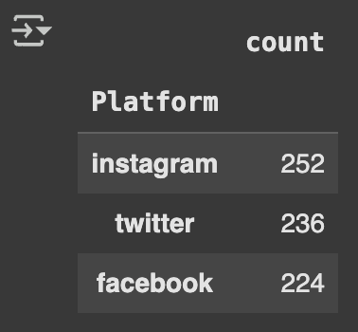
About dataset:
Platforms used: Most frequent sentiments:

Slide 6
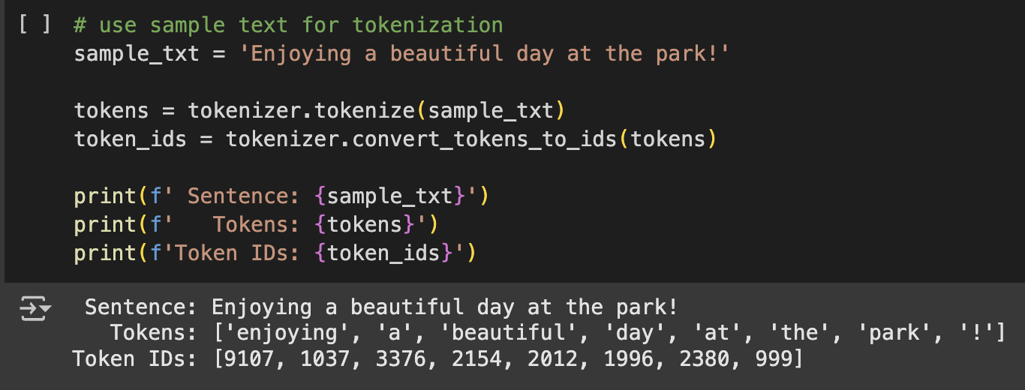
Model:
The NLP Text-Sentiment Analysis was done using distilBERT.
For example:

Slide 7
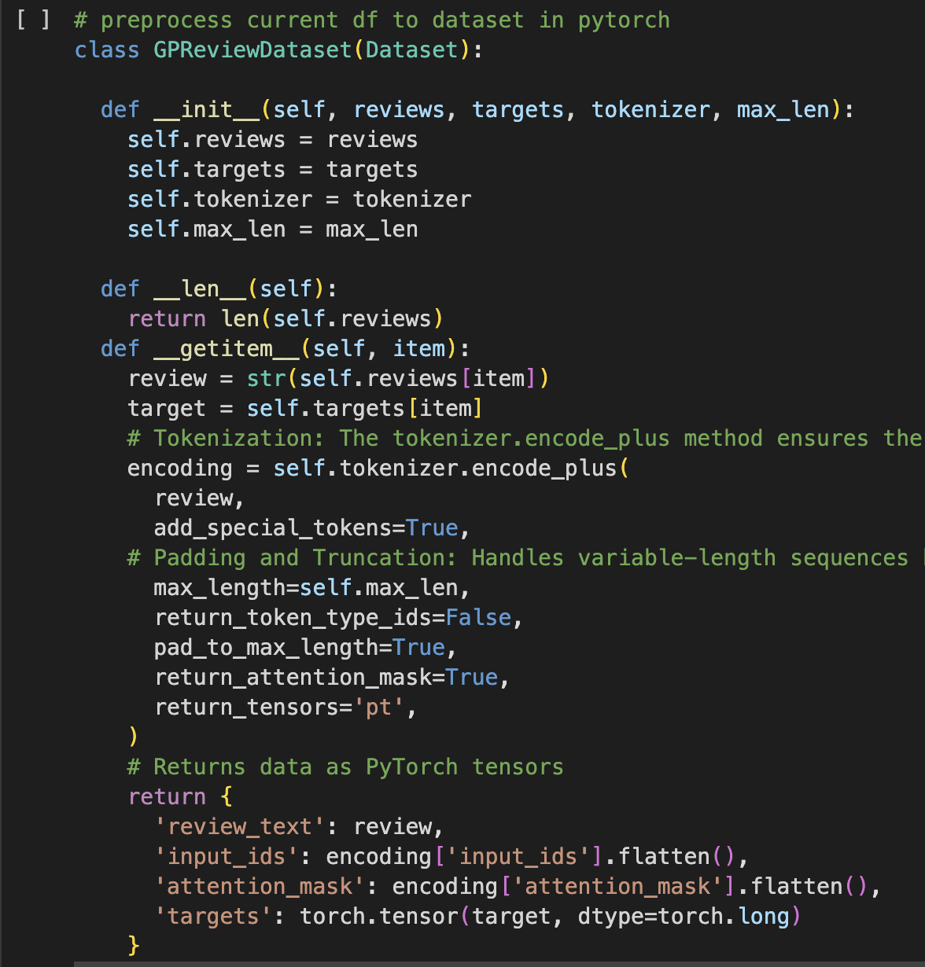
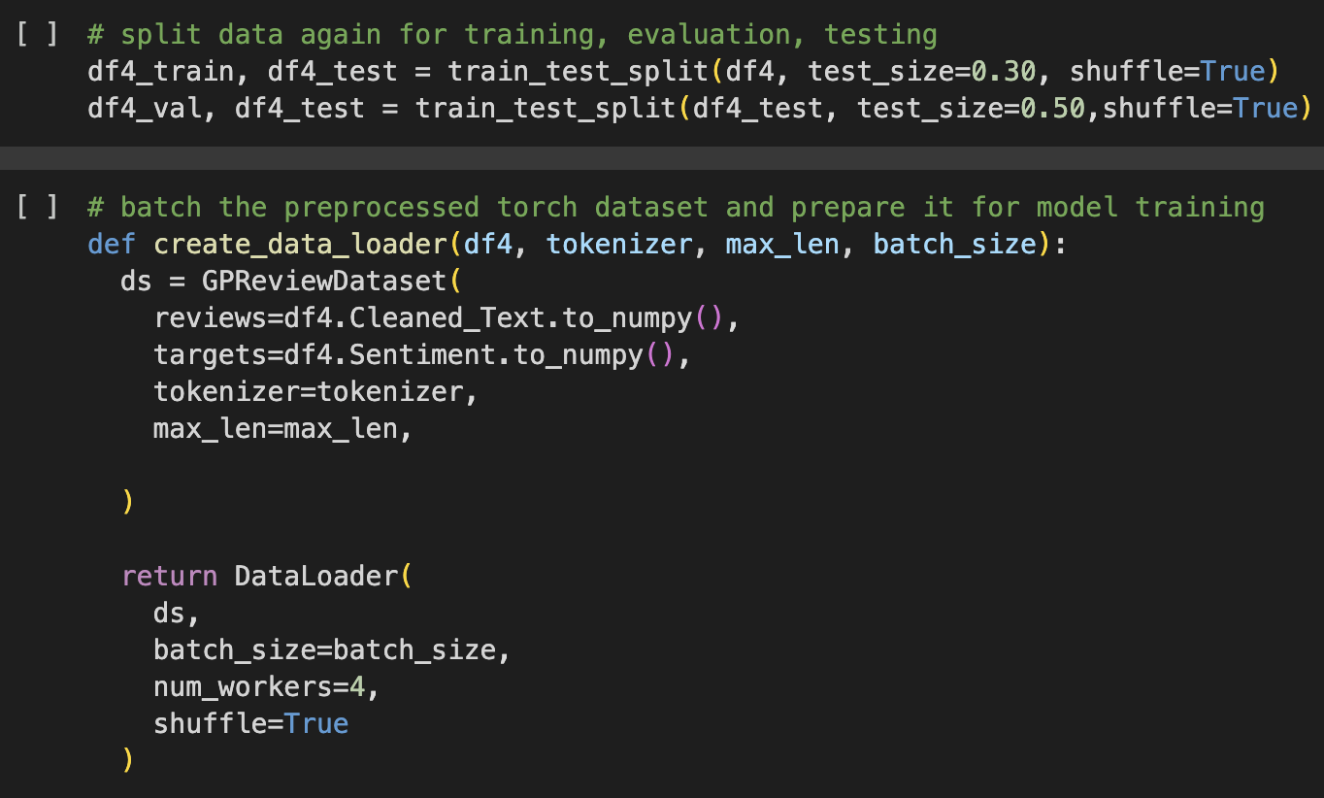
Code snippets for data preparation using PyTorch:

Slide 8
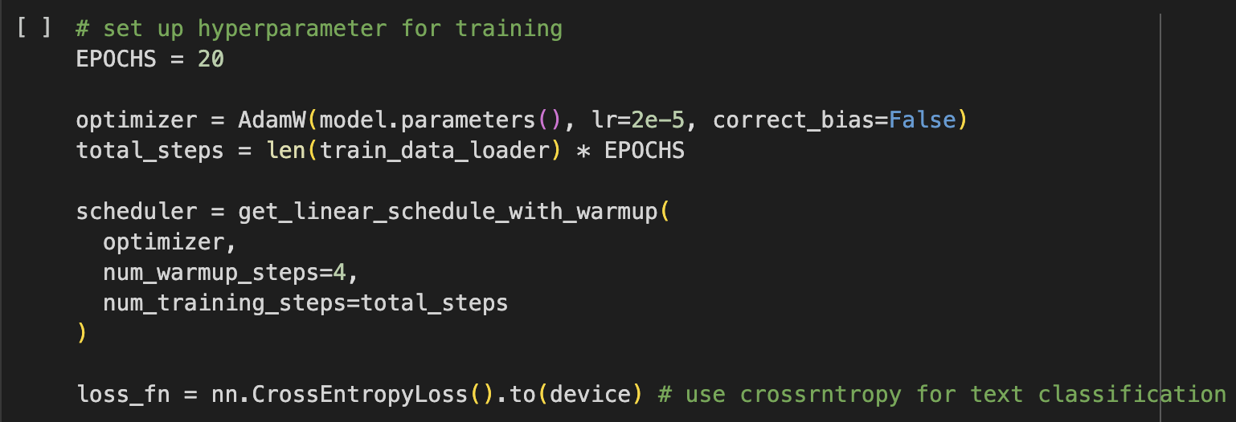
Hyperparameters used for training the model:

Slide 9
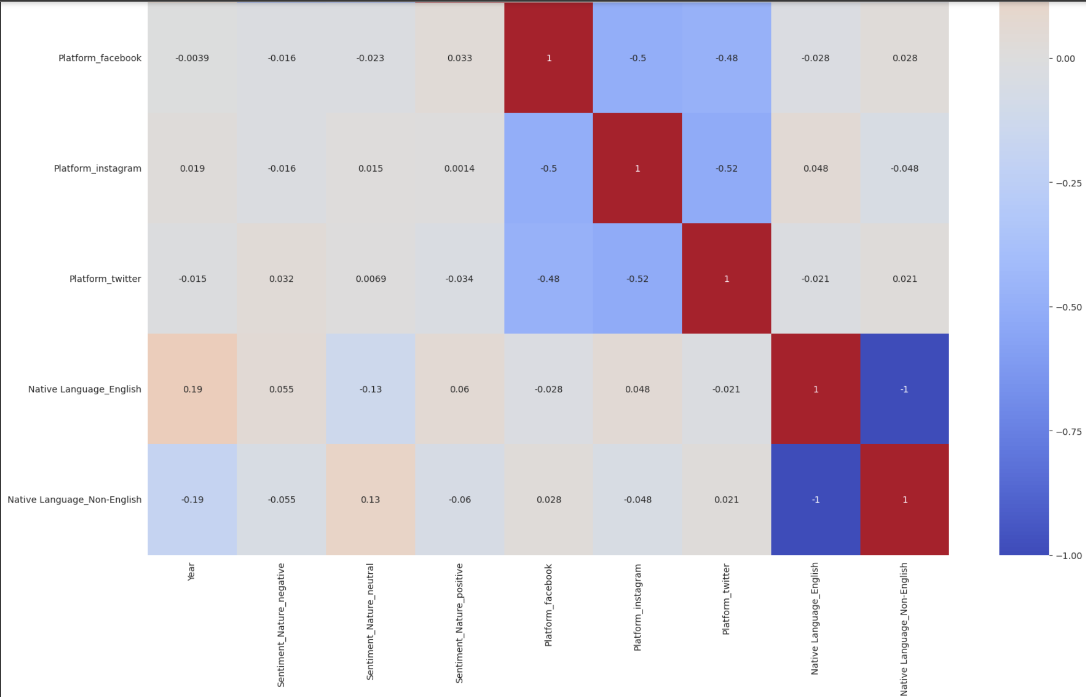
Correlation correlation between 'Sentiment_Score' and 'Year', 'Platform', and 'Native Language’:

Slide 10
Correlation correlation between 'Sentiment_Score' and 'Year', 'Platform', and 'Native Language’:
Based on the correlation analysis, it is interesting to see:
Positive posts are more time-sensitive, and becoming more positive over the year.
Neutral posts are more language-sensitive, where non-English speaker tend to write neutral posts, which might be due to the language barrier, or mislabeling in sentiments.
On the other hand, negative posts are more language-sensitive, in terms of having English speaker writing negiva posts, which might be due to the tendency to express negative feelings in native language.

Slide 11
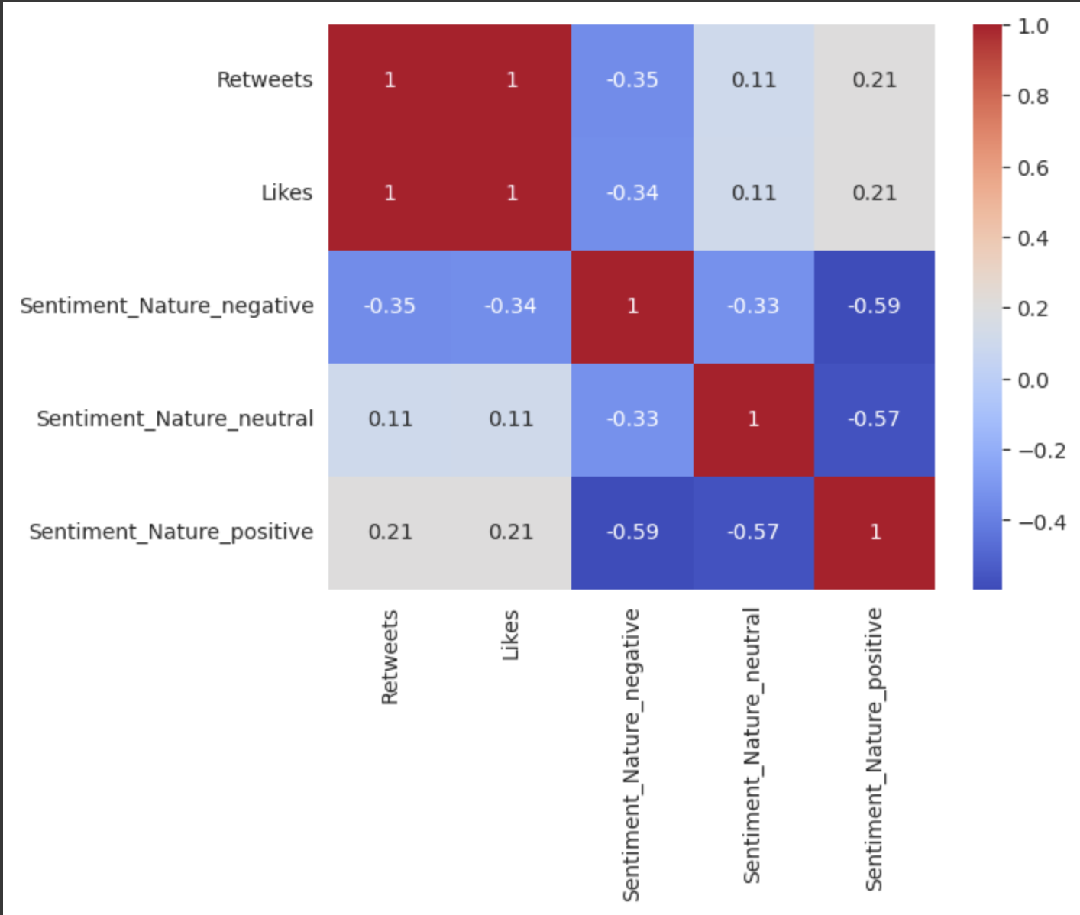
Sentiment Correltion with Retweets & Likes

Slide 12
Sentiment Correltion with Retweets & Likes
Based on the correlation analysis, it is interesting to see:
Positive posts tend to get more retweets and likes, which validate our hypothesis.
Neutral posts have tend to get less retweets and likes, but they are still positively correlated.
Negative posts shows all negative coorelation, which shows that negative posts do not tend to get more likes and retweets.

